Slide 1

The Art of Machine Learning
Ali Pesaranghader
AI Research and Data Science
CIBC
July 19, 2019

Slide 2
Overview
Chapter I: Machine Learning
Machine Intelligence
The Dragon & The Knight
Inductive Bias
Version Space
Occam’s Razor
Sample Complexity
PAC Learning
VC Dimension
Bias and Variance
No Free Lunch Theorem
Curse of Dimensionality
Chapter II: Deep Learning
Convolutional Neural Networks
Recurrent Neural Networks
Transformers
GANs
Chapter III: Engineering
Documentation
Coding Paradigms
Design Patterns
Quality Measures
Chapter IV: Evaluation
Procedures
Measures
Statistical Tests

Slide 3


Chapter I: Machine Learning

Slide 4

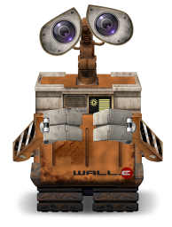

Machine Intelligence
Machine Learning:
A computer system learns:
if it improves its performance or knowledge due to experience,
if it adapts to a changing environment.
Turing Test
No!
Blah!
Gill
Robot
Blah?
Alex

Slide 5


The Dragon
Data
(Head)
Knowledge
(Wings)
Algorithms
(Tail)

Slide 6

The Knight
Wisdom
Experience
Audacity

Slide 7
A Little Spice of Philosophy?
Neo vs. Morpheus
https://www.youtube.com/watch?v=fhrNgXJ__n8

Slide 8

Inductive Bias
Inductive bias refers to a set of (explicit or implicit) assumptions made by a learning algorithm in order to perform induction.
In other words, we want to generalize a finite set of observations (training data) into a general model of the domain.
Day 1: Sunrise around 5:30 to 5:45
Day 2: Sunrise around 5:30 to 5:45
Day 3: Sunrise around 5:30 to 5:45
Day 4: Sunrise around 5:30 to 5:45
Day 5 ???

Slide 9
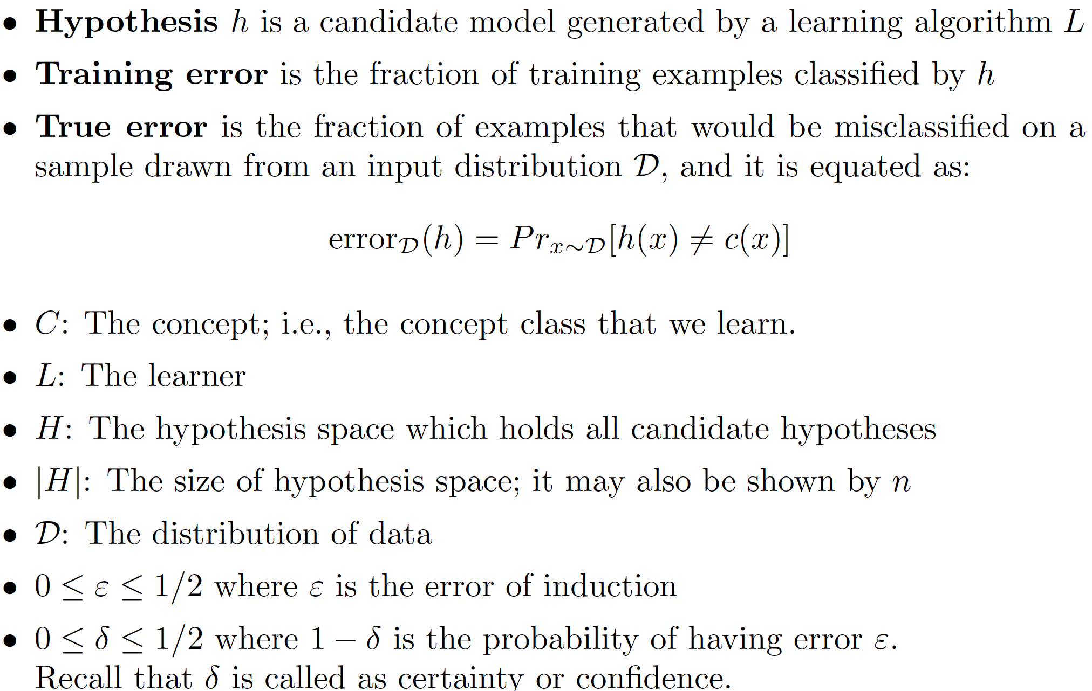
Terminology

Slide 10
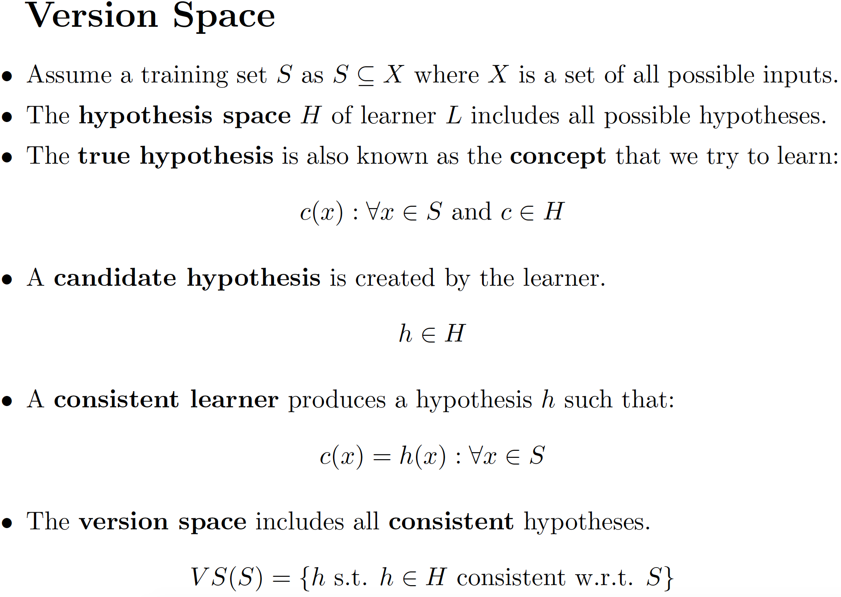
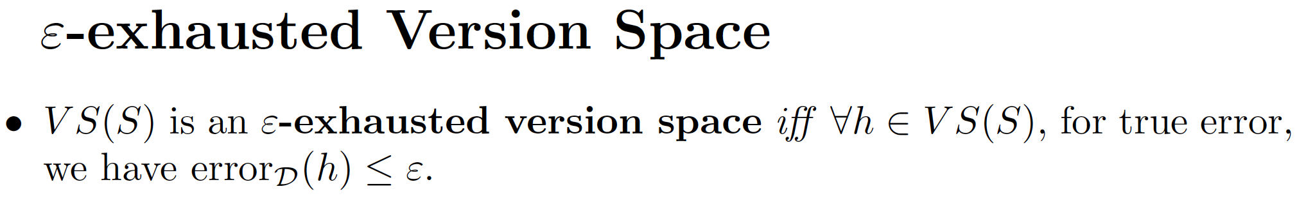
Version Space and ℇ-exhausted Version Space

Slide 11
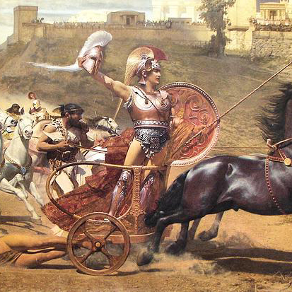
Occam’s Razor
Occam’s razor is a classical inductive bias, such that:
The simplest consistent hypothesis about the target function is actually the best.
Recall computational complexity and resources available to learners:
Time
Space
Data
Achilles vs. Boagrius: https://www.youtube.com/watch?v=_z5UKystdZg

Slide 12
Sample Complexity
How many training examples are needed for a learner to create a successful hypothesis?
PAC Learning – when the hypothesis space is finite
VC Dimension – when the hypothesis space is infinite

Slide 13
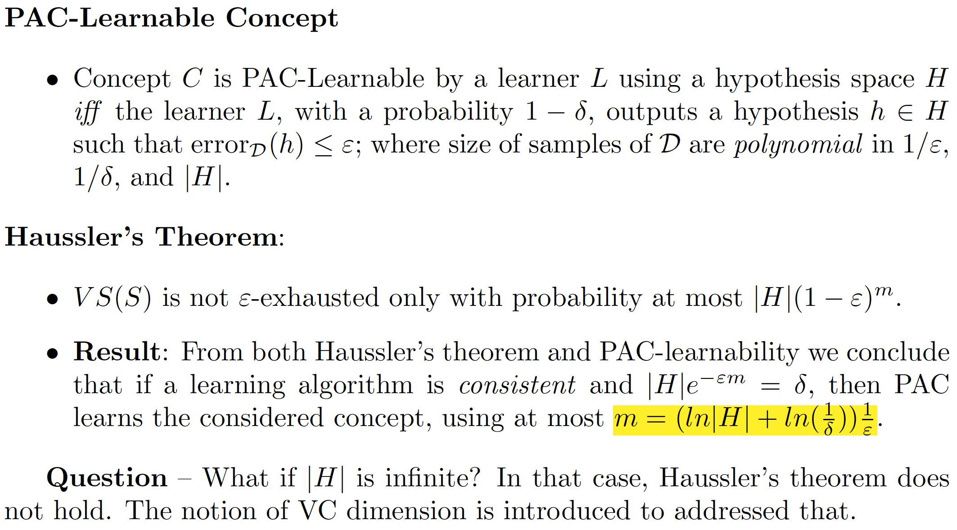
PAC Learning and Haussler Theorem

Slide 14
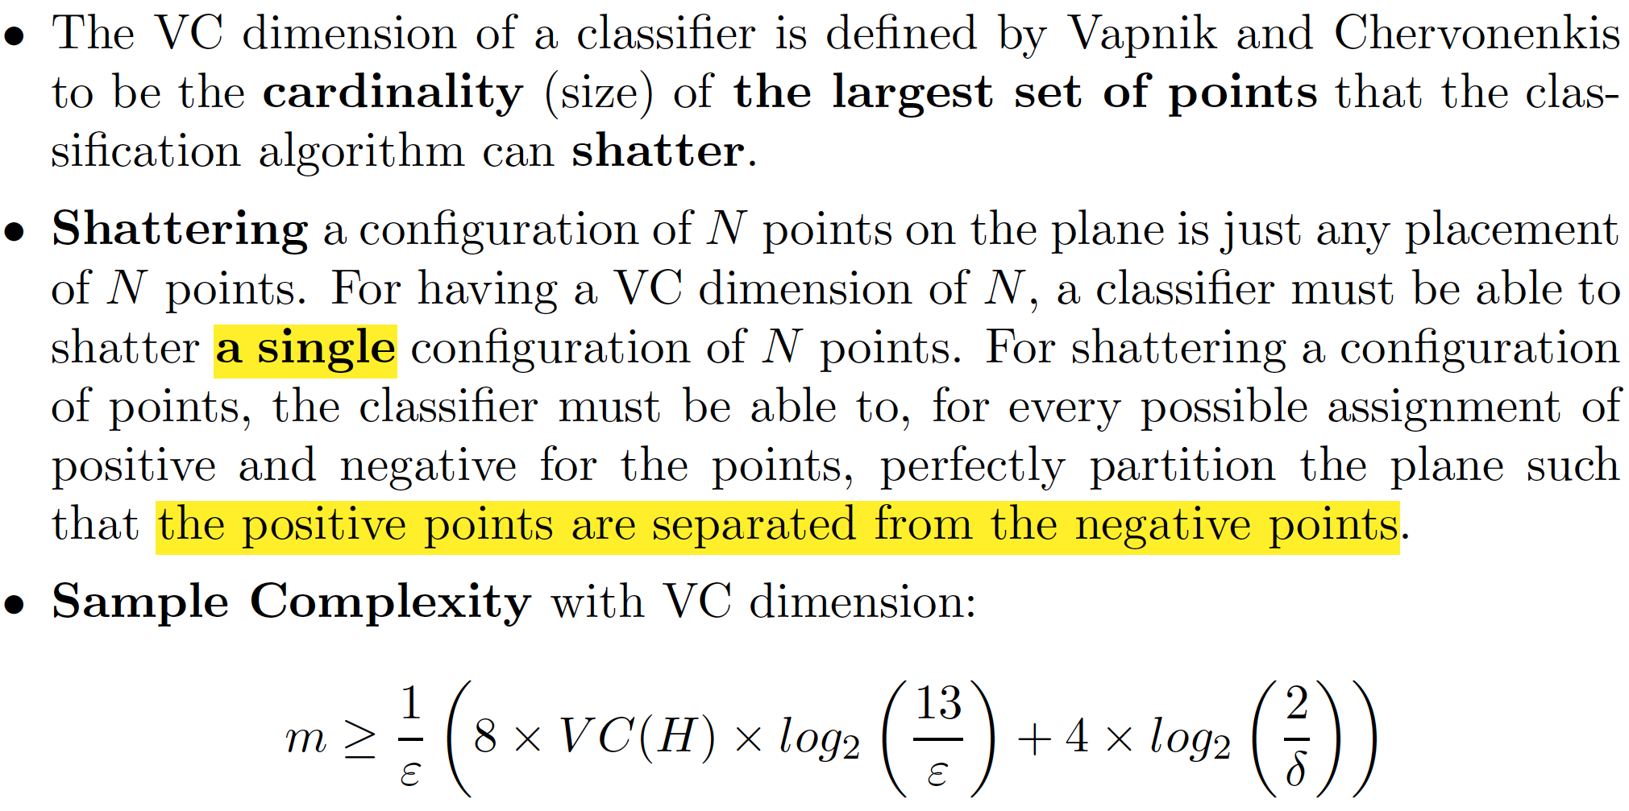
VC Dimension

Slide 15
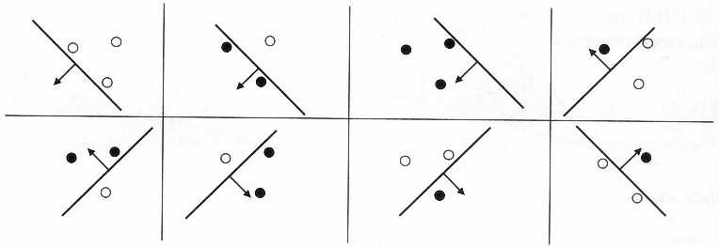
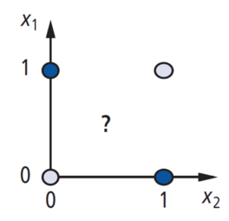
VC Dimension – Example
Configuration of 3 Points
We successfully separate positive and negative points from each other
A shattering of 4 Points
Where we fail to draw a line to separate positive points from negative ones

Slide 16
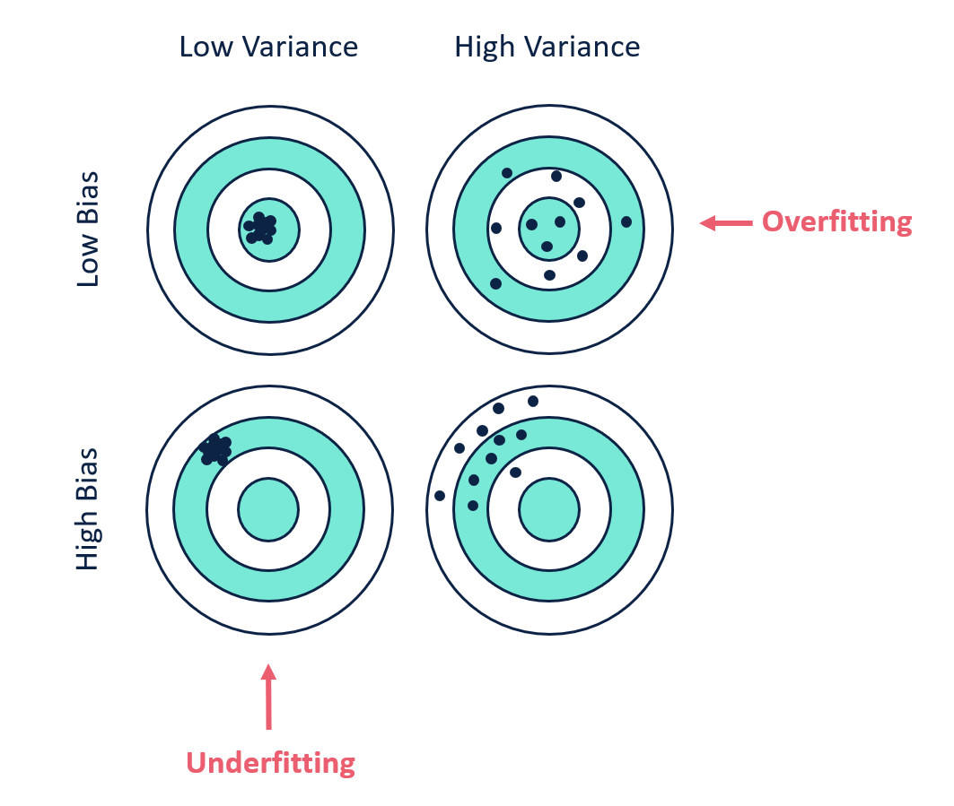
Bias and Variance
Model Complexity:
A too-flexible model has high variance and low bias, whereas a too-strict model has low variance and high bias.
Ideally, we want a model with both low-variance error and low-bias error.

Slide 17
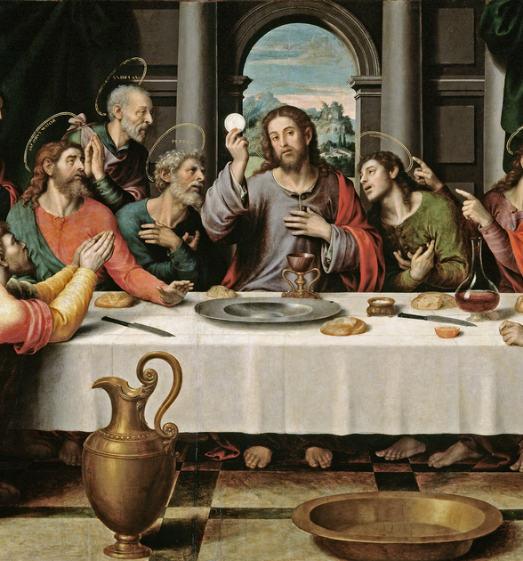
No Free Lunch Theorem
Every classiﬁcation algorithm has the same error rate, averaged overall possible data-generating distributions.
In other words, in some sense, no machine learning algorithm is universally any better than any other.
So the goal of machine learning research is not to seek a universal learning algorithm or the absolute best learning algorithm, but to understand what kinds of machine learning algorithms perform well on a given data.

Slide 18
Curse of Dimensionality
The curse of dimensionality refers to various phenomena that arise when analyzing and organizing data in high-dimensional spaces that do not occur in low-dimensional settings.
Problem I: This sparsity is problematic for any method that requires statistical significance. In order to obtain a statistically sound and reliable result, the amount of data needed to support the result often grows exponentially with the dimensionality.
Problem II: Organizing and searching data often relies on detecting areas where objects form groups with similar properties. In high dimensional data, however, all objects appear to be sparse and dissimilar in many ways, which prevents common data organization strategies from being efficient.
More Problems? Matrix Inversion, Optimization, etc.

Slide 19

Chapter II: Deep Learning

Slide 20
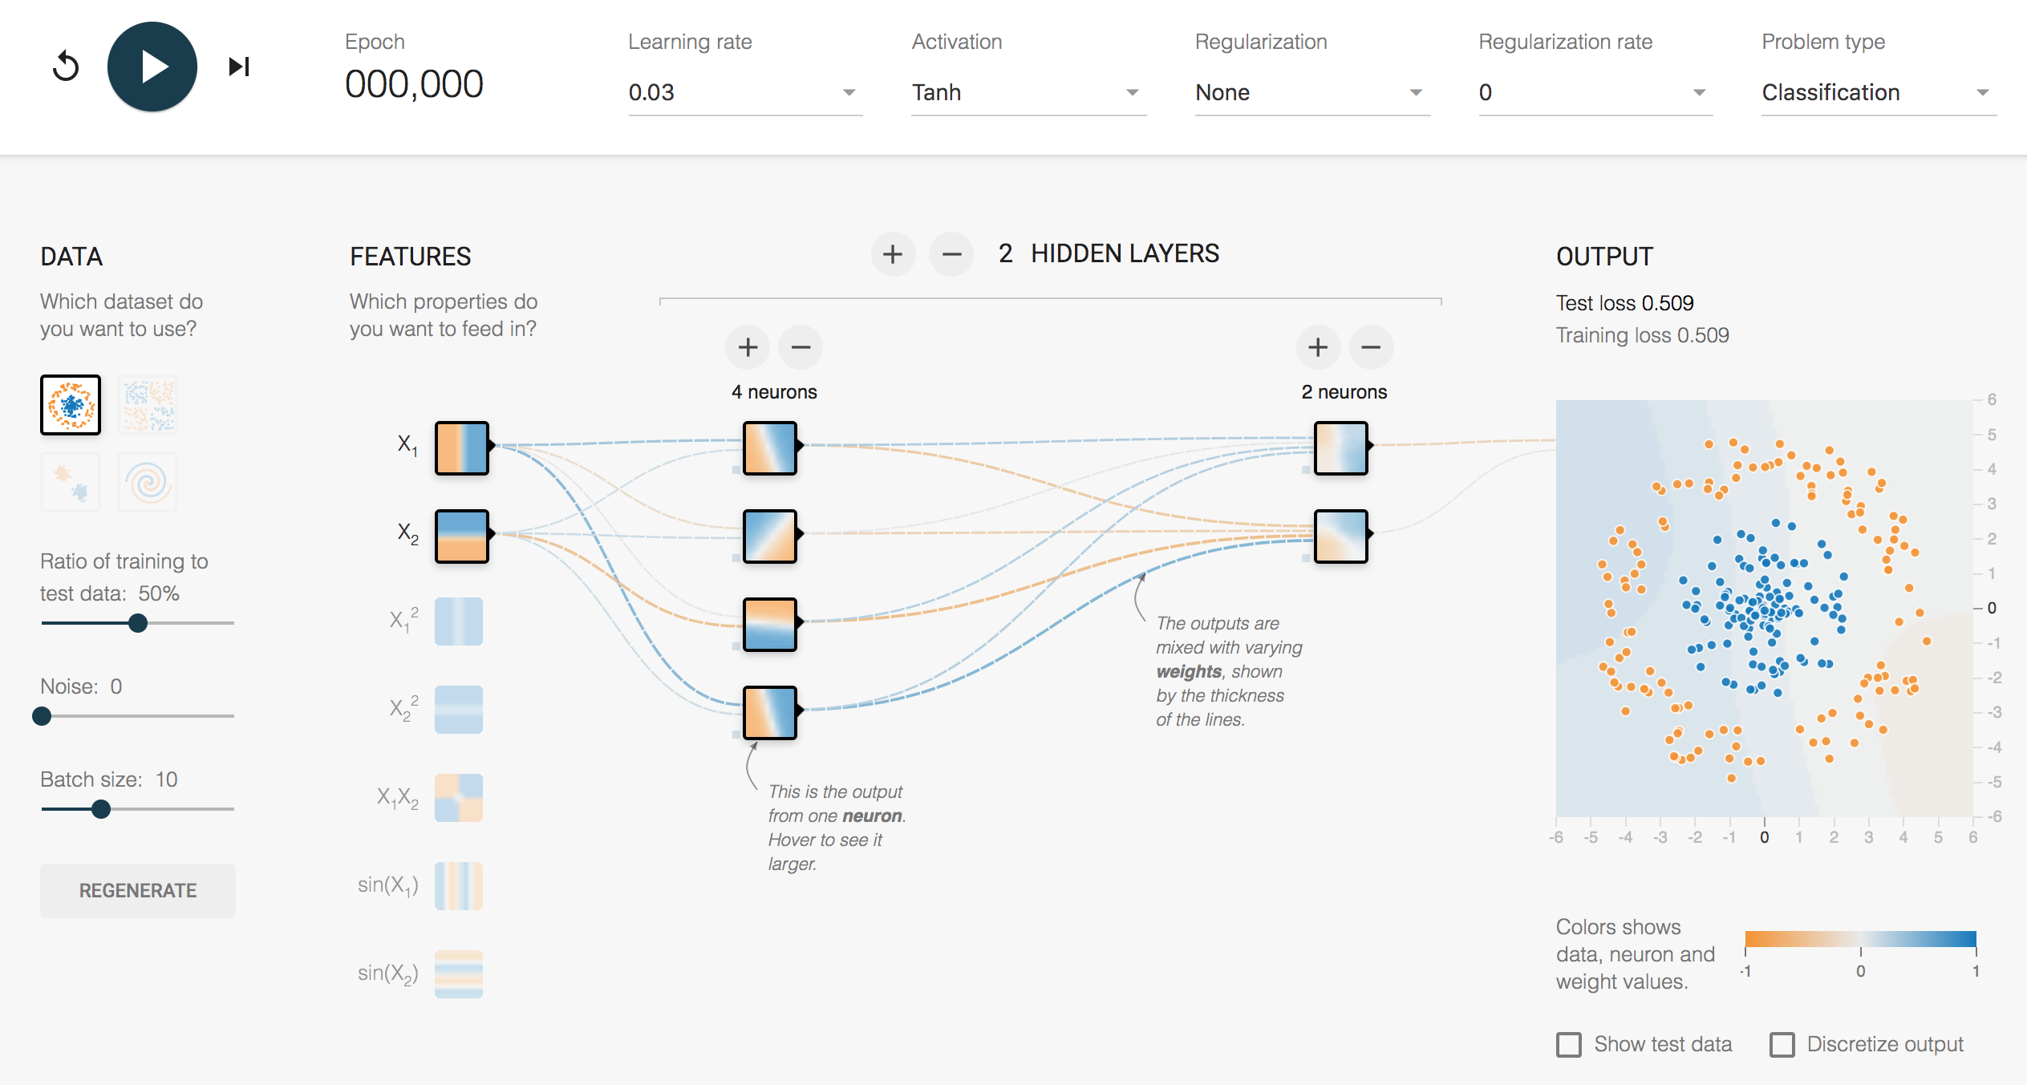
Artificial Neural Networks
https://www.youtube.com/watch?v=3JQ3hYko51Y

Slide 21



Convolutional Neural Networks (CNNs)
Andrej Karpathy
Convolution Demo: http://cs231n.github.io/convolutional-networks/ *
MNIST: https://cs.stanford.edu/people/karpathy/convnetjs/demo/mnist.html
CIFAR10: https://cs.stanford.edu/people/karpathy/convnetjs/demo/cifar10.html *
Adam Harley
MNIST: http://www.cs.cmu.edu/~aharley/vis/

Slide 22
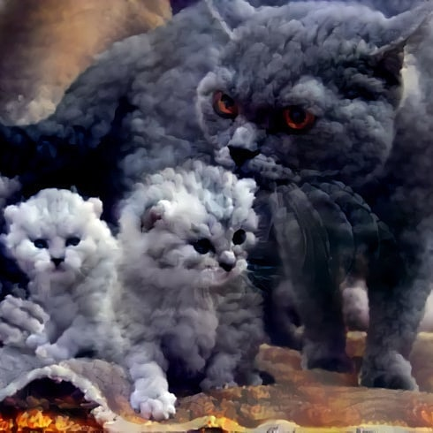
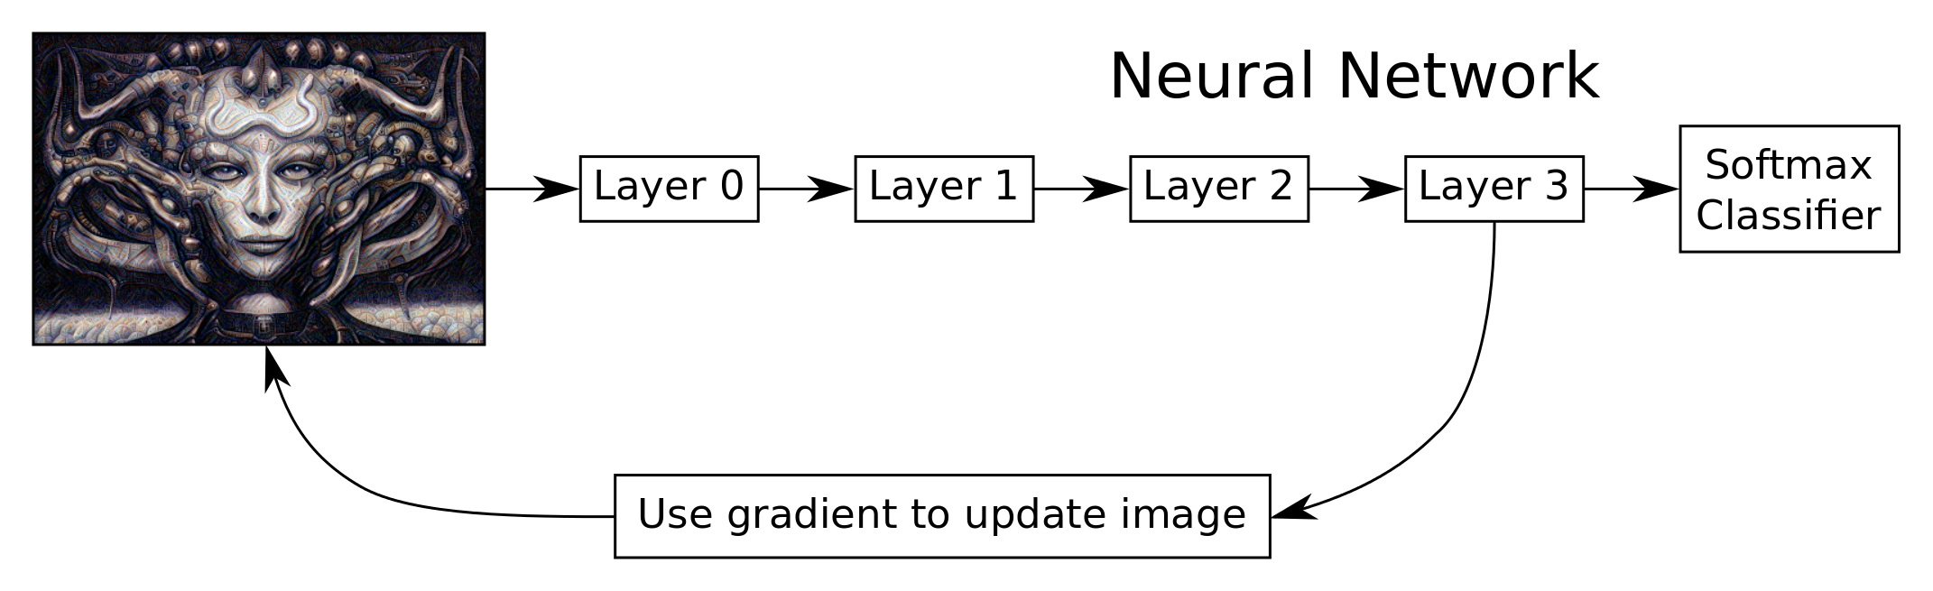
CNNs Applications
Understanding CNNs:
http://yosinski.com/deepvis#toolbox
Deep Dream:
https://www.youtube.com/watch?v=DgPaCWJL7XI
https://www.instagram.com/deepdreamgenerator/
Google: https://github.com/google/deepdream

Slide 23



Recurrent Neural Networks (RNNs)
Vanilla RNN
Encode Sequence
Vanishing Gradient
Exploding Gradient
Cannot Memorize and Emphasize Cores in Sequences
Chris Olah: http://colah.github.io/posts/2015-08-Understanding-LSTMs/

Slide 24
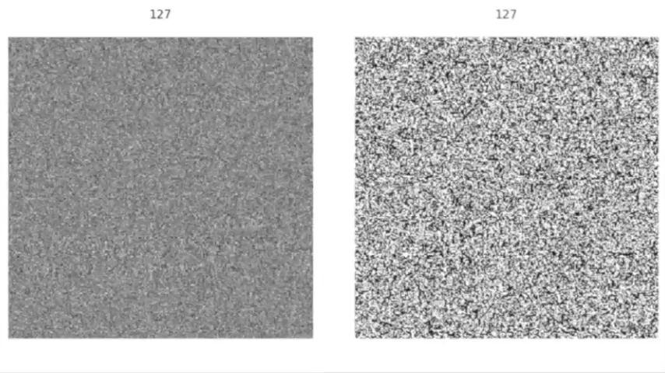

Recurrent Neural Networks – Cont.
Long Short-Term Memory (LSTM)
Encode Sequence
Solve Vanishing Gradient Problem
Cannot Memorize and Emphasize Cores in Sequences
Gradient Vanishing
Vanilla RNN vs. LSTM
https://imgur.com/gallery/vaNahKE
Chris Olah: http://colah.github.io/posts/2015-08-Understanding-LSTMs/

Slide 25
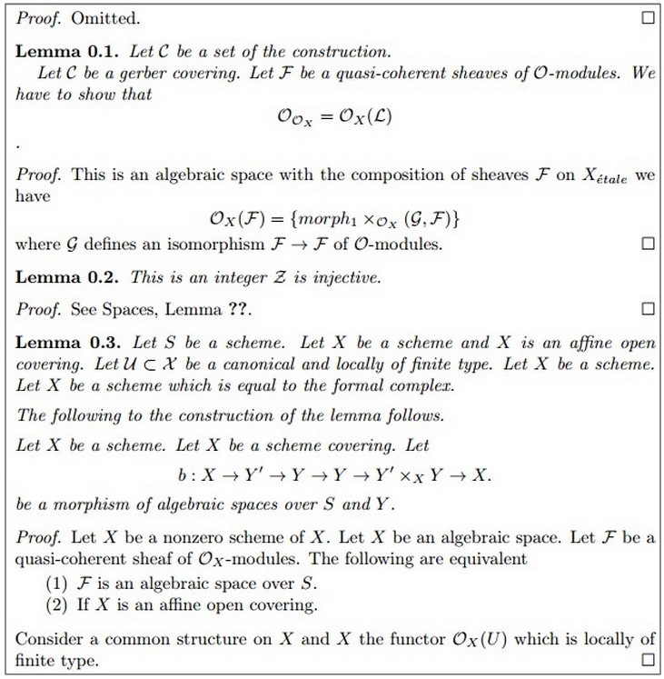
RNNs Applications
Text generation
Andrej Karpathy: http://karpathy.github.io/2015/05/21/rnn-effectiveness/

Slide 26
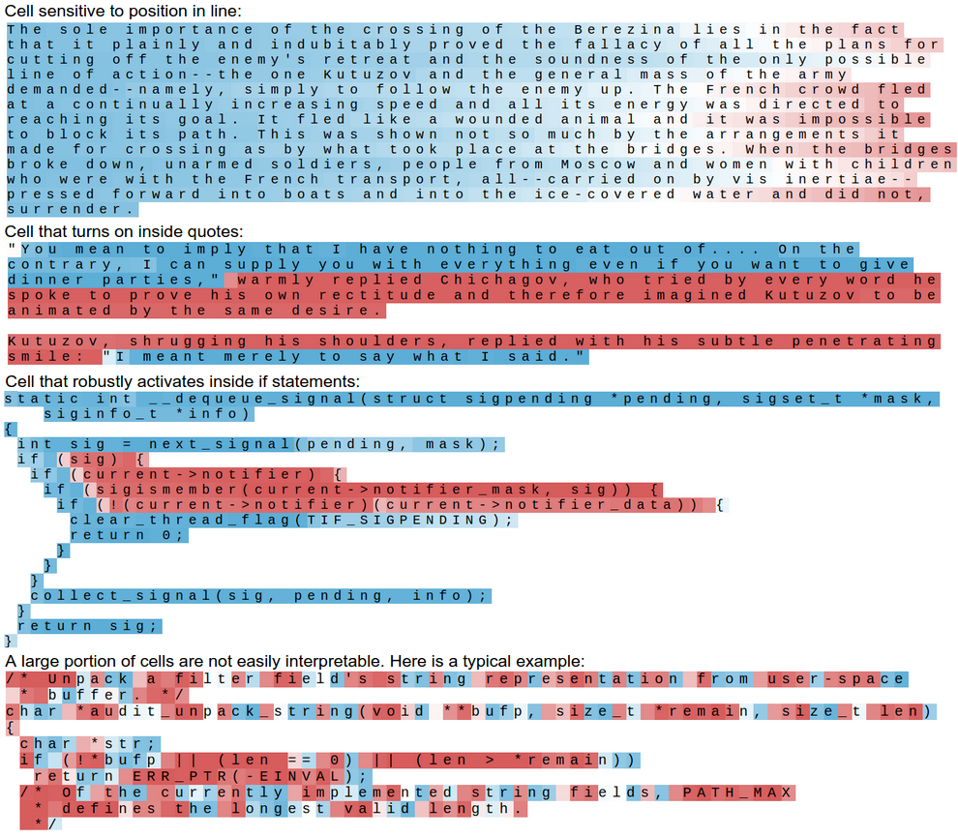
RNNs Applications
Text generation
Code generation
Move Scripts https://arstechnica.com/gaming/2016/06/an-ai-wrote-this-movie-and-its-strangely-moving/
Andrej Karpathy: http://karpathy.github.io/2015/05/21/rnn-effectiveness/

Slide 27
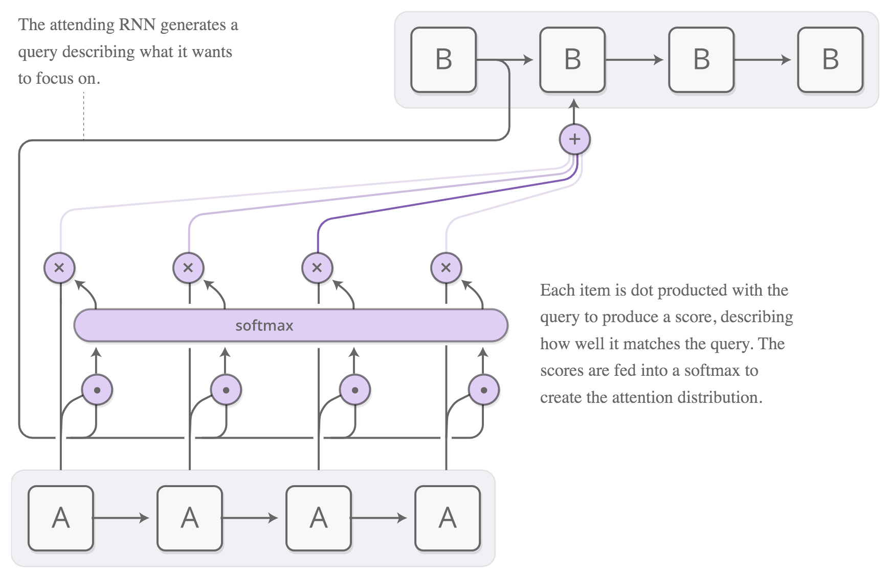
Attention Networks
How can we pay special attention to some parts of a sequence? Attention!
The attention distribution is usually generated with content-based attention.
The attending RNN generates a query describing what it wants to focus on.
Each item is dot-producted with the query to produce a score, describing how well it matches the query.
The scores are fed into a softmax to create the attention distribution.
Chris Olah: https://distill.pub/2016/augmented-rnns/#attentional-interfaces

Slide 28

Transformers
Relying entirely on self-attention to compute representations of its input and output,
Based on that, draw global dependencies between input and output
No recurrence or convolutions,
More parallelizable and requires significantly less time to train,
Attention is All You Need. Vaswani A., et al. https://arxiv.org/abs/1706.03762

Slide 29
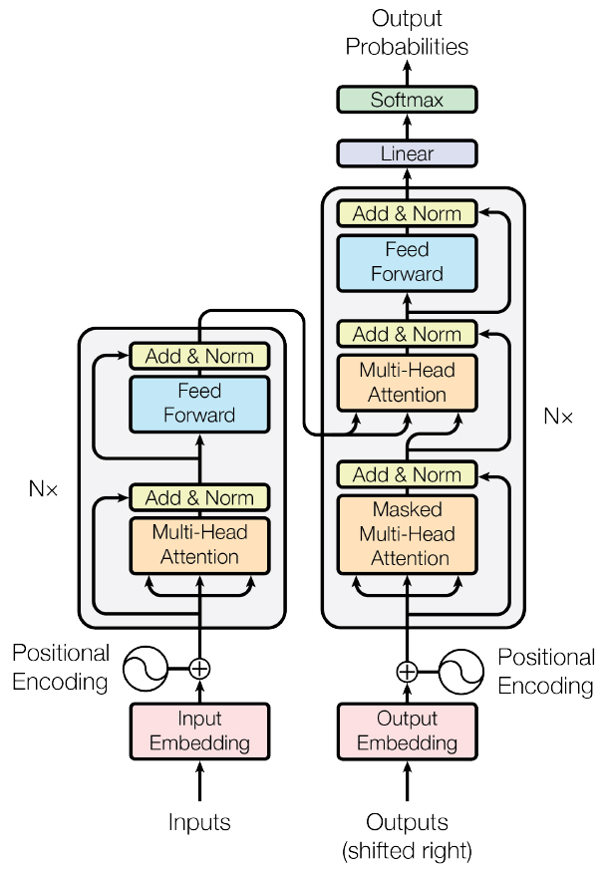
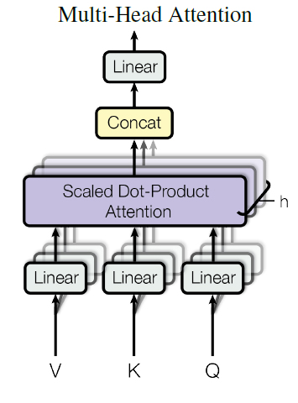
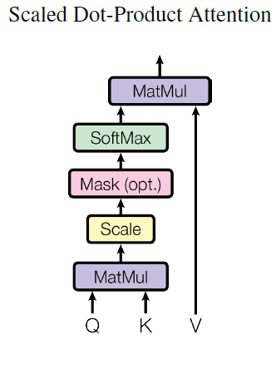
Transformers – Cont.
Attention is All You Need. Vaswani A., et al. https://arxiv.org/abs/1706.03762

Slide 30
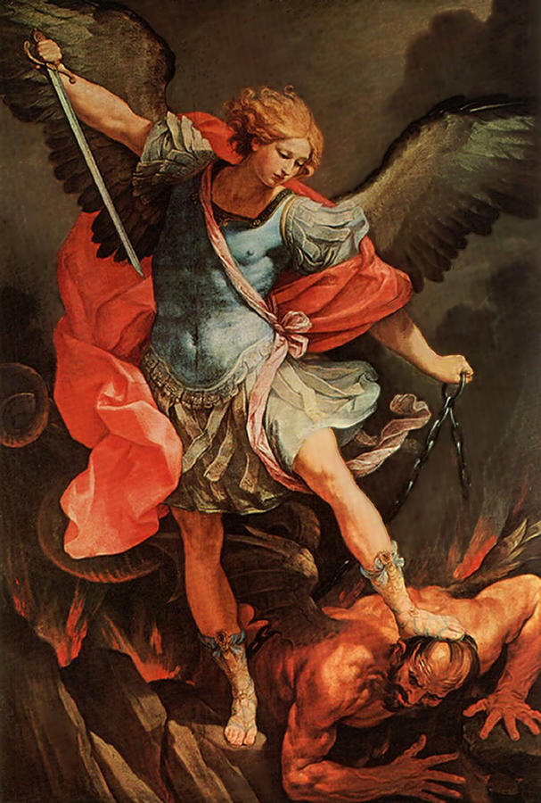
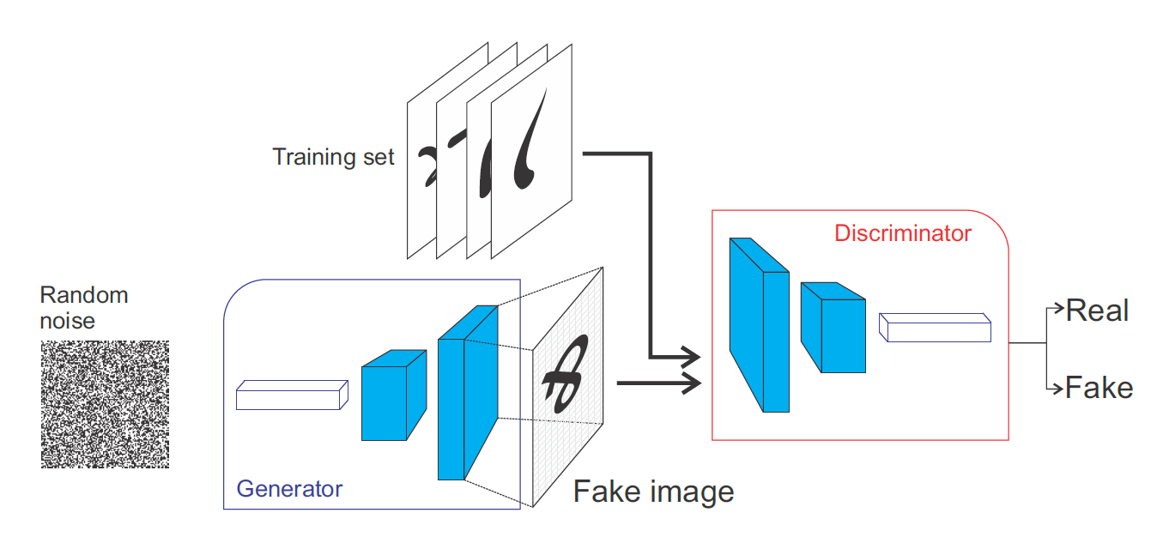
Generative Adversarial Networks (GANs)

Slide 31



GANs - Applications
Music Composing:
https://aiva.ai/creations
Image Enhancement:
https://www.youtube.com/watch?v=d7OXb2sqoec
Style Transferring by StyleGANs:
https://www.youtube.com/watch?v=kSLJriaOumA
Let’s make it happen! (click)

Slide 32
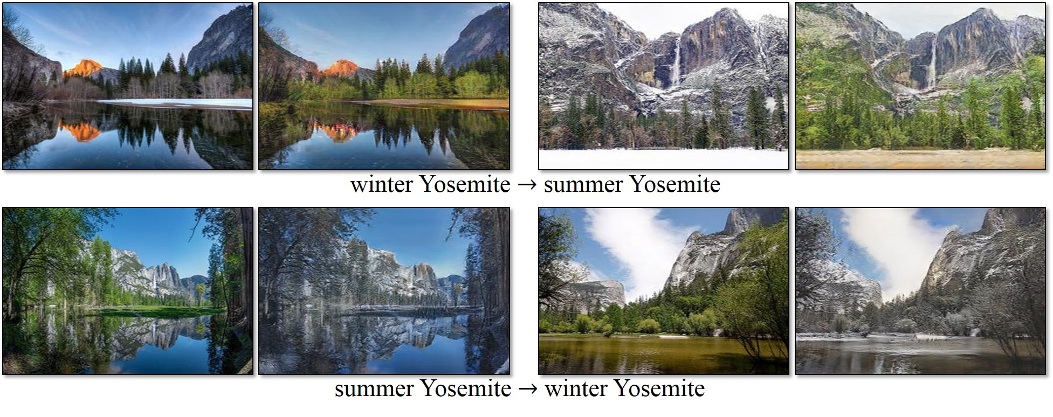
GANs - Applications
Domain Adaptation by CycleGANs:
https://junyanz.github.io/CycleGAN/
https://www.youtube.com/watch?v=iHv6Q9ychnA
https://www.youtube.com/watch?v=WSoR42TnWJM
https://www.youtube.com/watch?v=Fea4kZq0oFQ

Slide 33

Chapter III: Engineering

Slide 34
Documentation
Documentation is as important as coding.
Save time, money, and avoid risk
Examples:
Requirement Specification Documentation
Design Documentation
2Vs and Test Documentation
User Manual and Installation Guide
IEEE Standards: http://tiny.cc/jwzg9y

Slide 35
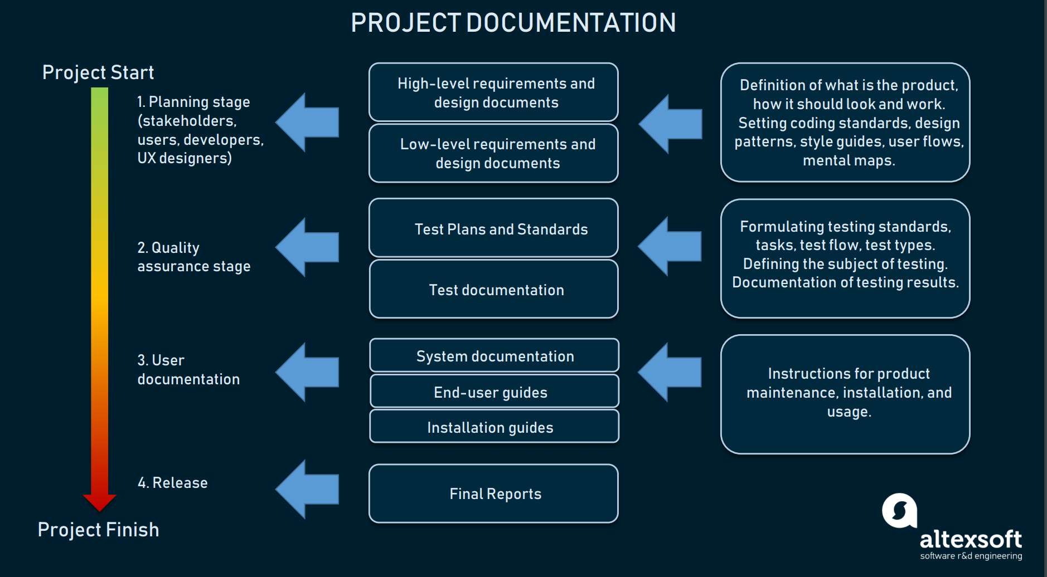
Documentation – Cont.

Slide 36
Design Patterns
Coding Paradigms
Sequential
Top-down codes with no modularity and no encapsulation
Functional
Top-down codes, in rare cases bottom-up codes, with modularity but with no encapsulation
Object-oriented
Crossed codes
Modularity
Encapsulation
Python: https://www.youtube.com/watch?v=bsyjSW46TDg
Java: https://www.youtube.com/watch?v=vNHpsC5ng_E&list=PLF206E906175C7E07
Further: https://github.com/faif/python-patterns

Slide 37
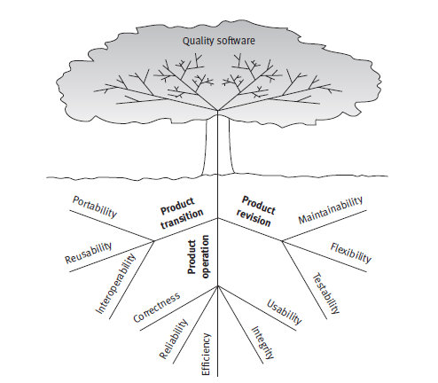

Quality Assurance and Metrics
McCall’s Quality Factors

Slide 38

Chapter IV: Evaluation

Slide 39
Procedures
Batch Setting
Online Learning
Holdout
70% Training, 30% Testing
K-Fold Cross-validation
Use when the dataset is small
Be aware of K, and re-sampling approach
Train-validation-test
For better generalization, and parameter tuning only on the validation set.
60% Training, 20% Validation, and %20 Testing
80% Training, 10% Validation, and %10 Testing
Don’t forget stratified sampling!
Online Holdout
Make sure the holdout set has a good representation of data-generating distribution
Prequential
A test-and-train approach,
Instance by instance
Batch Prequential
Test a batch first, then train it
Batch by batch

Slide 40
Measures
Data Balanced?
Go ahead and use accuracy!
Otherwise:
Type I Error (False Positive) and Type II Error (False Negative)
Precision and Recall
F-Measure
G-Mean
ROC and AUC
Cohen’s Kappa

Slide 41
Statistical Tests

Slide 42

Q&A

